Slide 1
HR Analytics dashboard
INFO 465 – Projects in Information Systems
Fall 2023
Sage Hoepfl

Slide 2
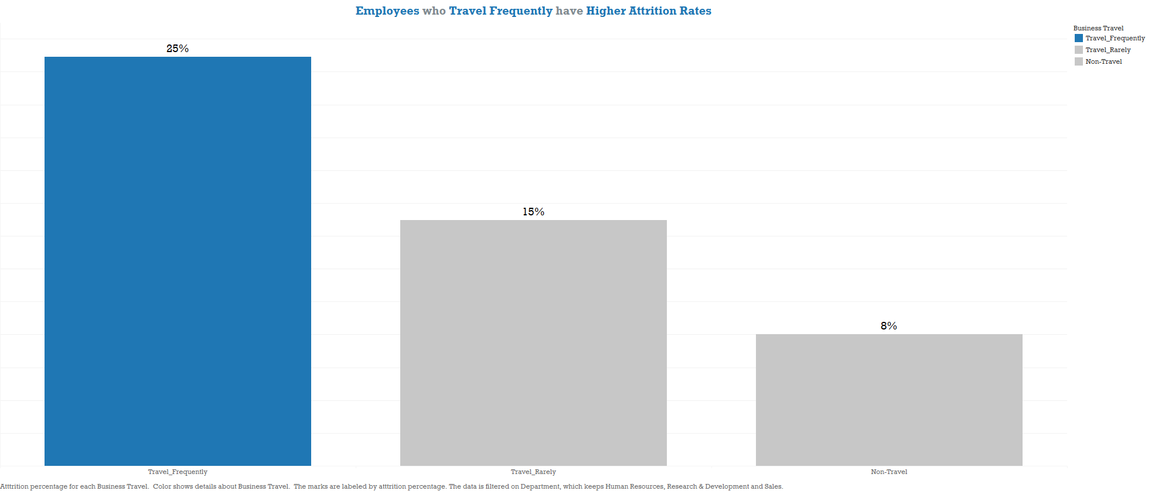

Slide 3
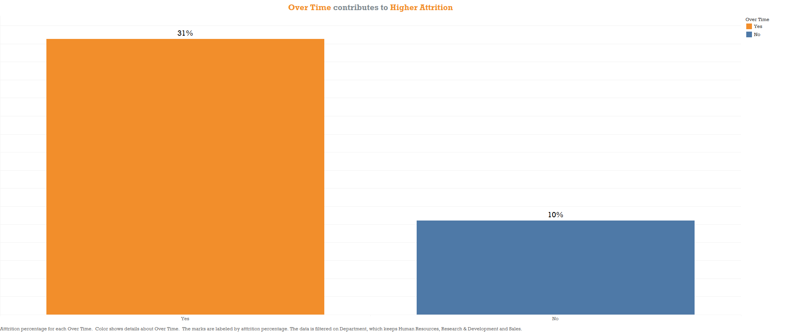

Slide 4
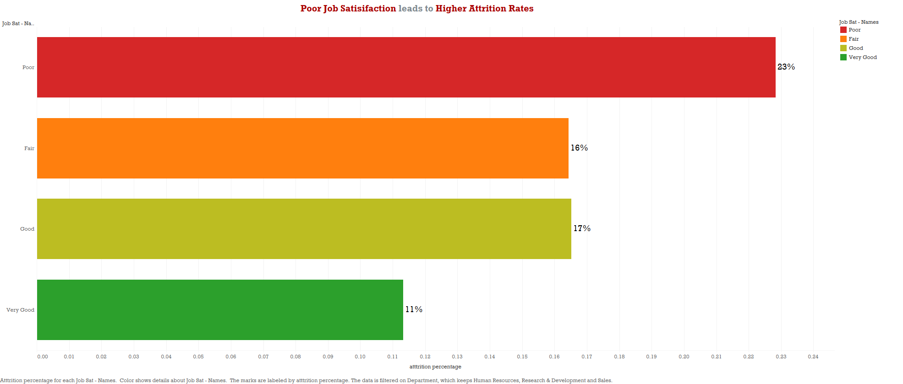

Slide 5
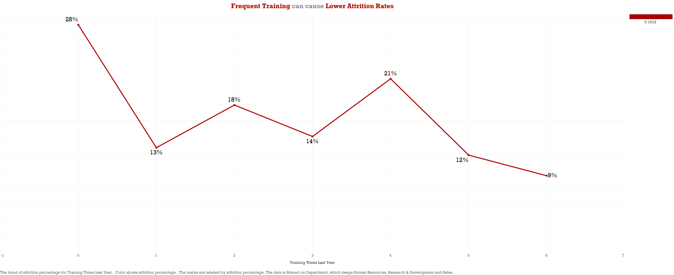

Slide 6
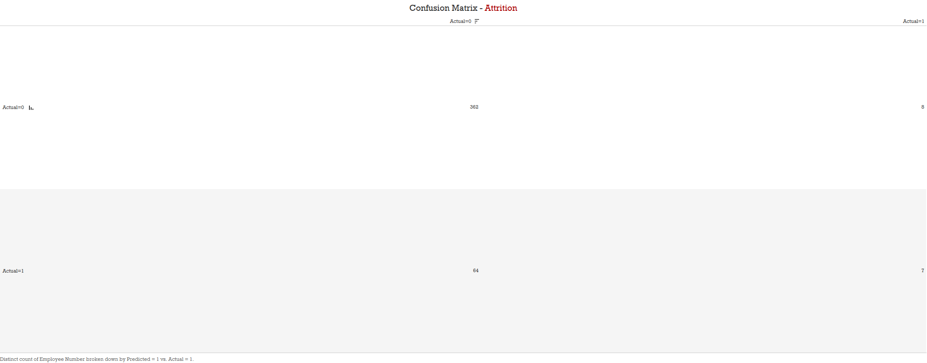

Slide 7
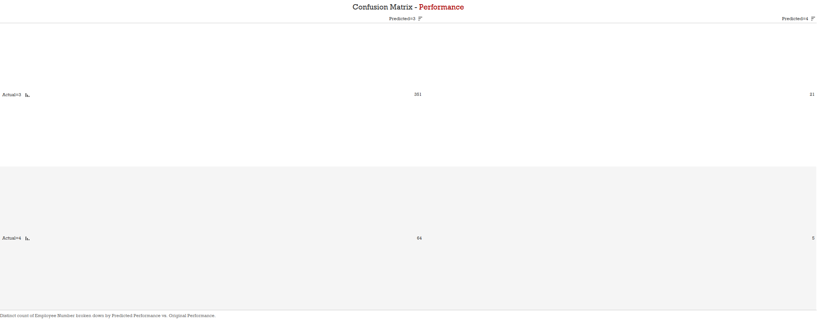

Slide 8
